Slide 1

Trendify

Slide 2

Overview
Our hypothesis: The growth of the popularity of an artist between 2021-24, we can be used to plan a European tour in 2025
Our business case: We have decided to create a data-driven business that gathers data from European Spotify accounts to create an artists solo tour around Europe
Why Spotify?
Data wrangling & cleaning
Exploratory Data Analysis
Teamwork & project management
Major obstacles
Conclusions & business implications

Slide 3

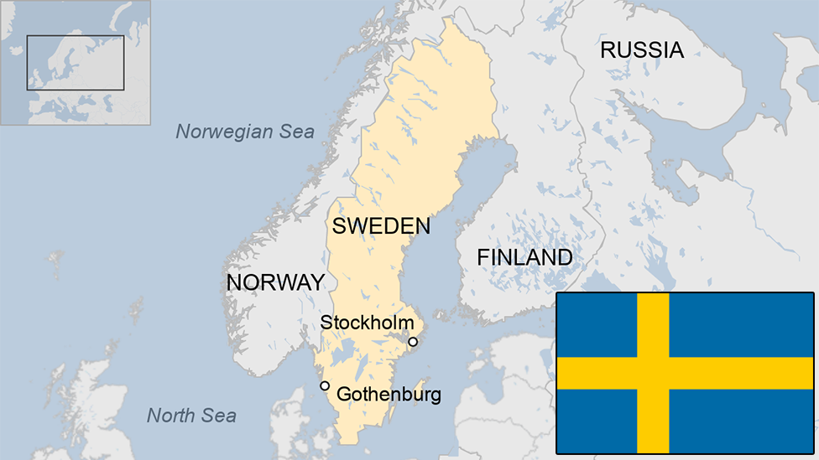
Why Spotify?
Officially launched in October 2008
Music and Podcast streaming service
Free & Premium
Available in 180 countries
Millions of artists & podcast creators
Over 500 million monthly active users globally
Over 200 million premium subscribers

Slide 4
Data wrangling & cleaning
Selecting the right data and discarding “good ones” but not good enough.
Nationality of listeners
Outdated information
"Top 200" and "Viral 50" became 1 and then 8
Dropping columns and aligning column names
Filtering through top 50 and only European daily ranks.
Making it standard:
ASCII format
Country codes or country name
Capitalization

Slide 5
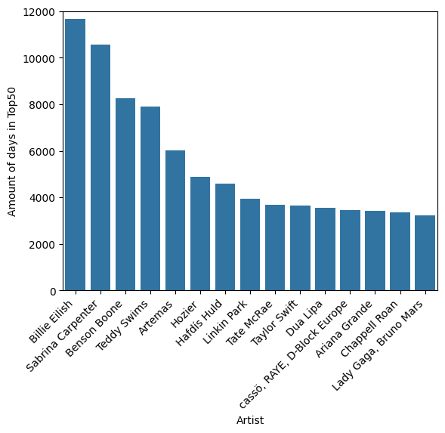
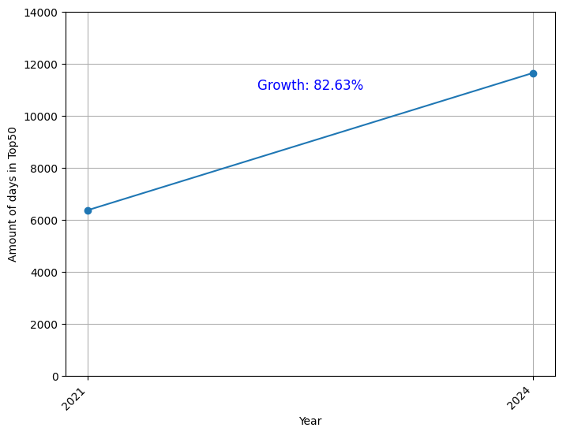
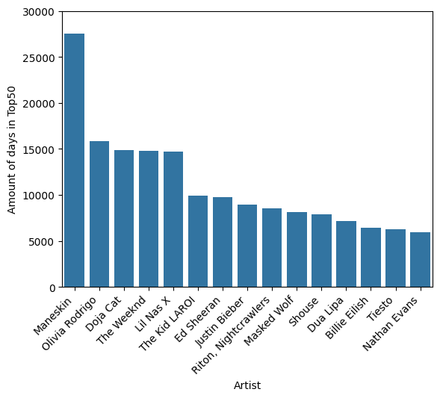
Exploratory Data Analysis (EDA)
Which artist grew in popularity between 2021 and 2024 and therefore shows potential for a successful tour in 2025?
2024
2021

Slide 6
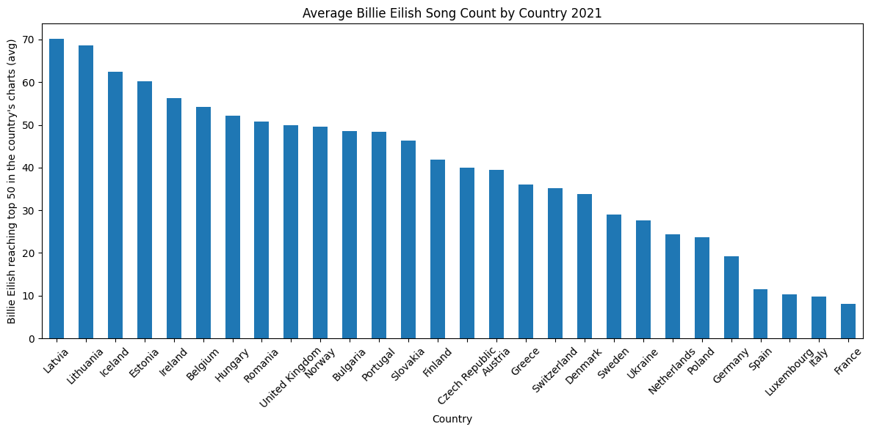
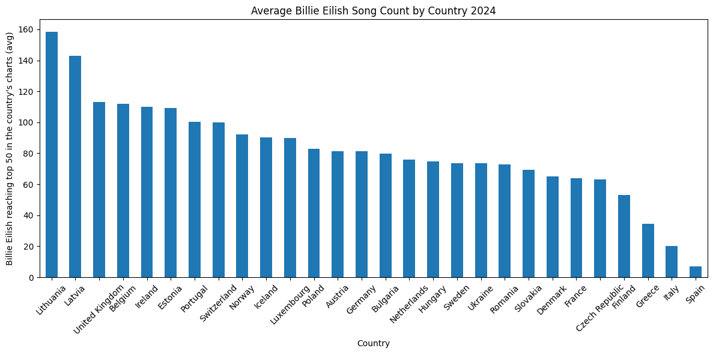
Exploratory Data Analysis (EDA)
Tour destinations based on artist’s popularity per countries in 2021 & 2024

Slide 7
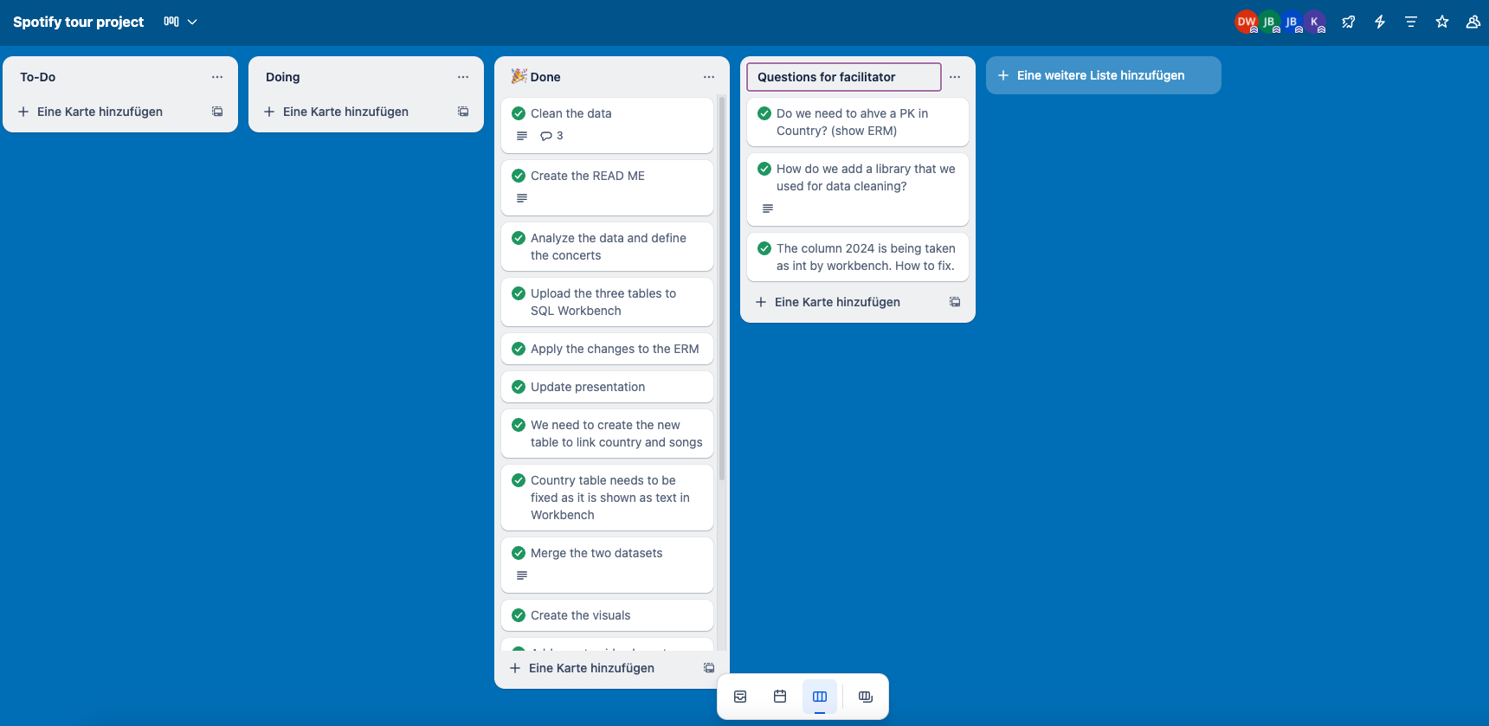
Teamwork & project management

Slide 8

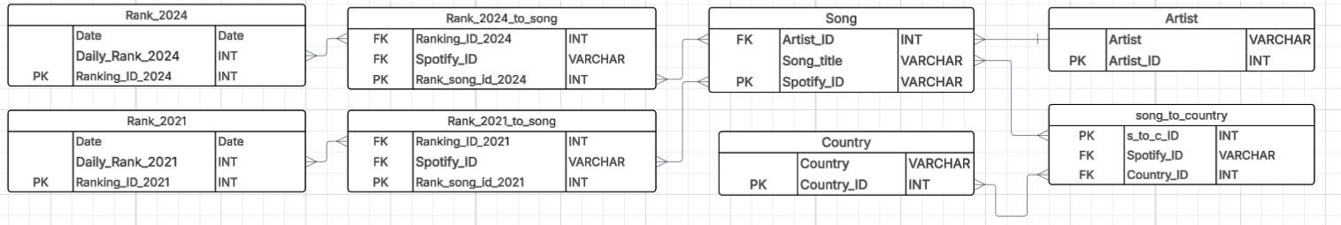
Major obstacles
ER - Model → linking the tables together
Heavy datasets 〜 3.5GB
Special characters
SQL issues (Importing, tables creation)→ moved on with Python
Scrapping 1.5 million rows to obtain the artist id.

Slide 9


Conclusions & business implications
Billie Eilish was selected
Lithuania, Latvia, United Kingdom, Belgium, Ireland and Estonia.
Can this project go further?
Can others be inspired by it?

Slide 10

Thank you for listening to Trendify
By Jesus, Jessica, Damian & Adam

